Slide 1
Saarloha Advanced Materials
Private Ltd,
Pune
Contact: Meetesh Kumar, Dy. Manager, Business Development; meetesh.kumar@saarloha.com; +91 9175993889

Slide 2
Kalyani Group Introduction

Slide 3
Kalyani Group Highlights
Turnover & Market Cap | Group Turnover ~US $ 3 Bn (in FY19) Market capitalization of listed entities ~ US $ 4.5 Bn (at the end of FY19)
End-to-End product & service offering | Complete integrated chain from Iron Ore to Steel to Finished Component supplier with strong R&D support
Leading Special Steels Manufacturer | India’s leading producer of Micro-Alloyed steel, used for manufacturing of Critical Auto-components (engine, transmission, powertrain, axles etc.)
Largest single location forging facility | Bharat Forge has world’s largest single location forging facility with a production of ~0.36MTPA
Largest Exporter | Largest Exporter of Auto-components from India Every 2nd Heavy Truck in US carries a Front Axle manufactured by Bharat Forge India
Global Leader in Powertrain & Chassis | Bharat Forge is the global Leader in Powertrain and Chassis components
Global, skilled workforce | Global workforce of 10,000+ with best skills in Quality, R&D, Operations, Technology and so on

Slide 4
Kalyani Group: A professionally managed Global Conglomerate
Segment | India | Europe | North America
Engineering Steel | Saarloha (formerly Kalyani Carpenter Special Steels) Kalyani Steels Baramati Sp. Steels
Forgings | Bharat Forge Kalyani Technoforge | BF CDP, Germany BF Daun, Germany BF Aluminumtechnik, Germany Mecanique Generale Langroise, France BF Kilsta AB, Sweden | Walker Forge, Tennessee, USA
Auto Components | Automotive Axles Maxion Wheels
Energy & Infrastructure | BF Utilities Khed Earth (SEZ)
Specialty Chemicals | Hikal Chemicals

Slide 5
Kalyani Group’s R&D Centers
Kalyani Centre for Technology and Innovation (KCTI)
Research ‐ Optimization of steel and forging process through advanced labs of Heat Treatment, Metallography, Fatigue, Creep Testing
Innovation ‐ Nano Technology, Battery Technology & Electronic Labs
Kalyani Centre for Manufacturing Innovation (KCMI)
Joint Engineering support during Product development.
Speedy Development of “A” and “B” Samples.
Establishing design for manufacture processes and technology.

Slide 6
Saarloha Introduction

Slide 7
About Saarloha Advanced Materials Pvt. Ltd (Saarloha)
1973: Founded as Kalyani Steels as a backward integration of Bharat Forge
1999: JV with Carpenter Technology Corporation (CTC, USA) to form Kalyani Carpenter Special Steels Ltd (KCSSL)
1999 – 2016: KCSSL matured into a leading producer of premium Alloy Steel Long Products, catering to Automotive, Oil & Gas, Nuclear, Defense, Railways, Aerospace and other critical engineering segments.
2016: Kalyani group bought CTC, USA’s stake and in 2018, changed the name of the company to Saarloha Advanced Materials Pvt. Ltd. (Saarloha)
Saarloha has state-of-the-art Inert ESR and VAR furnaces
Today, it has an annual crude steel capacity of 244,000 MTPA; Details of facilities are given in subsequent slides

Slide 8
Our Strengths
Manufacturing Flexibility – in terms of raw material use & production routes
Customized Product Development
Clean Steel Technology – by virtue of re-melting facilities
Wide Range of Grades
Wide Range of Sizes
In-House Research & Development team and facility
Expertise in understanding customer needs and hence offering best solutions

Slide 9
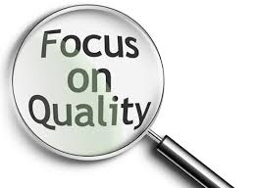
Quality Policy
We are committed to high standards of Customer satisfaction and will strive for Continual Improvement in our manufacturing processes to ensure sustained and consistent quality of our products and services.
Objectives
Implement and maintain effective quality system.
Make continual improvement in manufacturing.
Up-grade technology for higher efficiency.
Control process through statistical techniques.
Endeavour to produce first time right.
Ensure timely delivery and consistent quality.
Train employees and monitor effectiveness.
Encourage active participation of employees.

Slide 10
Saarloha’s In-house R&D (1/2)
Saarloha R&D center is approved by DSIR (GOI) and involved in continuous improvement of steel.
Major thrust Areas of R&D:
New Product Development
FEM Modeling & Simulation
Process Improvement
Advanced Material Characterization
Saarloha’s in-house R&D center consists of metallurgical experts, process experts and is well equipped with testing facilities like Mechanical Properties, Metallography, chemical analysis and NDT. FEM & Simulation is a major strength of R&D team to predict the properties of wide range of steel grades which supports in process improvement. We are continuously working to improve the product quality along with our customers and are successfully meeting their expectations.

Slide 11
Saarloha’s In-house R&D (2/2)
We have successfully developed products and processes for our customers from segments like Energy, Defence, Aerospace, Oil & Gas sectors etc.
Saarloha’ s testing facility and experts team provides technical support and in-house failure analysis for our customers.
R&D also has a 100 kg Prototype Induction Furnace – which is utilized to develop special and new steel grades.

Slide 12
Certifications
NADCAP Accreditation for H2 determination in Ti alloy
IATF 16949:2016
ISO 9001:2015
ISO 14001:2015 & OHSAS 18001:2007
LRS (Lloyds Register of Shipping)
DNV (DET NORSKE VERITAS) Norway,
ABS (American Bureau of Shipping)
KR (Korean Register of Shipping)
NKK (Nippon Kaiji Kyokai)
Central Boiler Board of India “ Well Known Steel Maker”
Laboratory Accredited by NABL
CCS (China Classification Society)
IRS (Indian Register for Shipping)
RINA, Geneva,
PED, TUV Nord
GL (Germanischer Lloyds)
Bureau Veritas
AS 9100 D
Germanischer Lloyd (GL)
Ordnance Factory, Ambajhari SO/IEC 17025:2005 (NABL)
Heavy Vehicle Factory, Avadi,
Ordnance Factory, Trichy

Slide 13
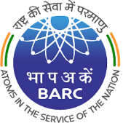
Saarloha – Approved Raw Material Supplier to various Defence & Aerospace institutions
 | Ordnance Factory, Ambajhari
 | Ordnance Factory, Kanpur
 | Heavy Vehicle Factory, Avadi
 | HAL
 | BrahMos Aerospace
 | NPCIL
 | BARC (Through L&T)
 | ISRO: LPSC, VSSC, HSFC
List not exhaustive

Slide 14
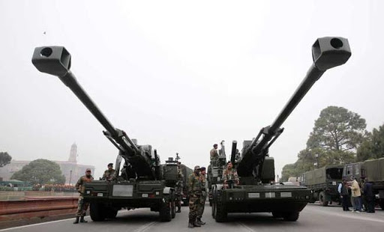
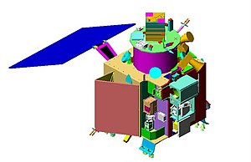
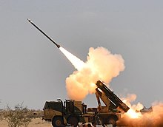
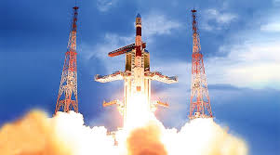
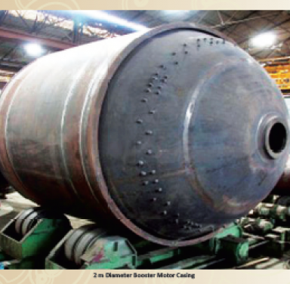
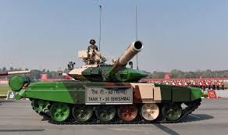
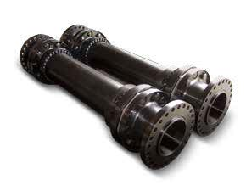
Saarloha’s steel for critical end-use applications
Gun Barrels
Missile Body casing (Pinaka)
Shells
Torsion Bars for tanks
Chandrayan1 (ISRO)
Gaganyaan (ISRO)
Rocket Casing (under development with DRDL & BFL)
Couplings for Aviation sector
List not exhaustive

Slide 15
Contribution to Indian Space, Defense , Nuclear & Railways “Make in India” Programme
We have successfully developed & supplied Critical
application Steels to:
Nuclear Power Corporation Ltd (NPCIL)
Nuclear Fuel Complex (NFC)
BHAVINI, Kalpakam (Nuclear power plant)
Bhabha Atomic Research Centre (BARC)
Vikram Sarabhai Space Centre (VSSC)
Liquid Propulsion Systems Centre (LPSC)
Ordnance Factories – Ambajhari / Avadi
Rail Wheel Factory – Bengaluru

Slide 16
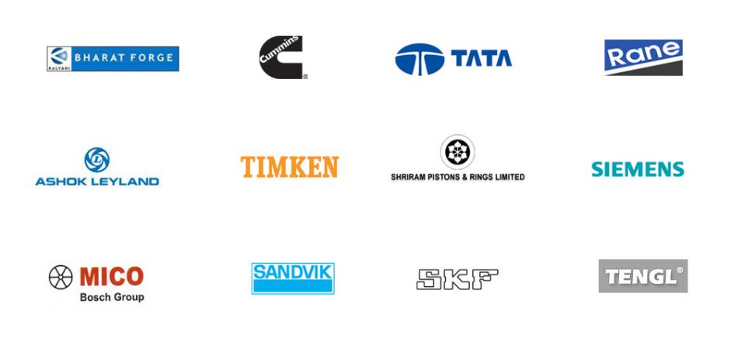
Our customers / End users (1/3)

Slide 17
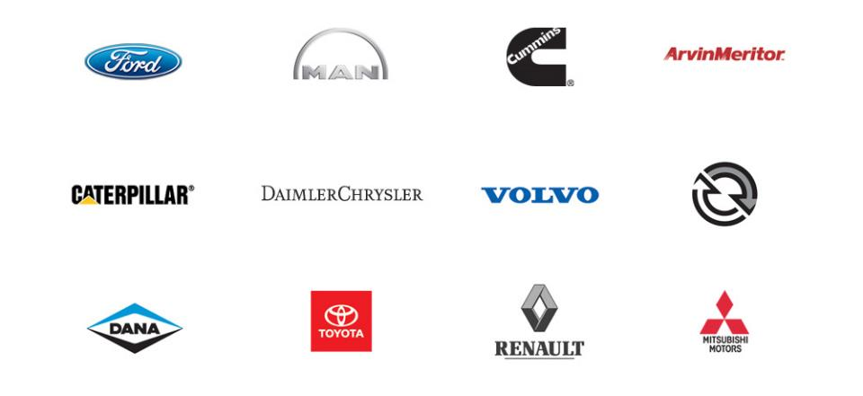
Our customers / End users (2/3)

Slide 18
Our customers / End users (3/3)
(Material handling)

Slide 19
Product Range
Carbon & Alloy Steels for Forgings & Engineering Applications
Tool & Die Steel – H11, H13, A2, SXI 99, S1, S7, O1
Valve Steels – En 52, SUH 3, SUH 11 etc.
Stainless Steels – AISI 304/304L, 316/316L, 403, 410, 17-4PH, Custom450 Etc.
Micro Alloyed Steels
Customized steels as per requirement
ESR & VAR route steels (elaborated separately)

Slide 20
Facilities at Saarloha

Slide 21
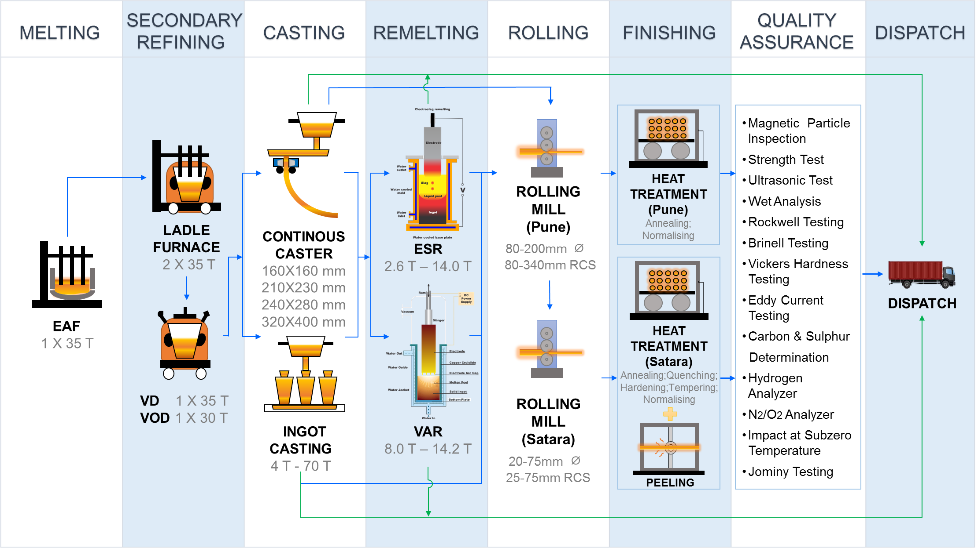
Process Flow (Steel Plant)

Slide 22
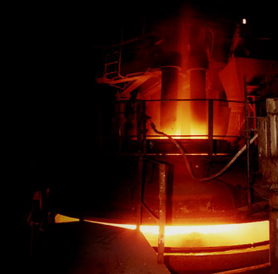
Facilities at Saarloha (Primary Melting Process)
Electric Arc Furnace
35 MT Capacity (ABB)
Transformer Capacity – 20/22 MVA
Slide Gate Assembly for Slag Free Tapping,
VLB (Virtual Lance Burners) for oxygen injection

Slide 23
Facilities at Saarloha (Secondary Refining Process)
Ladle Furnace
35 MT Capacity - 2 Nos. (ABB)
Wire Feeding Capability
Continuous Argon purging
Automatic Ferro Alloy Addition System
VD & VOD
VD/VOD (MAN GHH – Germany)
Vacuum less than 1 mbar
Continuous Argon purging
Tank Degassing Type with 6 Ejectors and 3 Boilers

Slide 24
Facilities at Saarloha (Casting)
Bloom Caster
Twin Strand Caster (Concast Technology & Automation by L&T)
Casting Radius 12 / 18 m
Ceramic Shroud from Ladle to Tundish
Tundish Capacity 7 MT
Alumina Graphite 4 port upward angled Sub Entry Nozzles from Tundish to Mould
Argon Shrouding of Tundish Stream
Turbo Stopper in Tundish
Bloom Sizes : C1-160x160, C2-210x230, C3-240x280, C4-320x400 mm

Slide 25
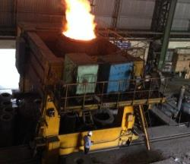
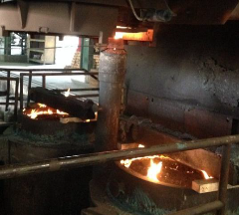
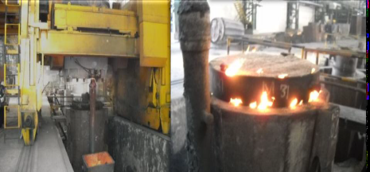
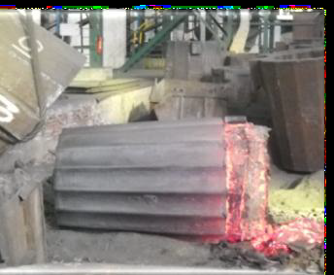
Facilities at Saarloha (Casting)
Ingot Casting Facilities
Ingot Weight 4 MT to 70 MT (Inteco)
Cast Iron and Spheroidal Graphite Iron Moulds
Bottom Pouring and Uphill Teeming
Wide End Up Moulds
Load Cell to monitor Rate of Liquid Metal Flow
Argon / Nitrogen Shrouding with failure
Alarm System; Facilities to cast ingots under vacuum

Slide 26
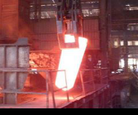
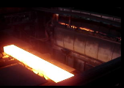
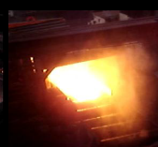
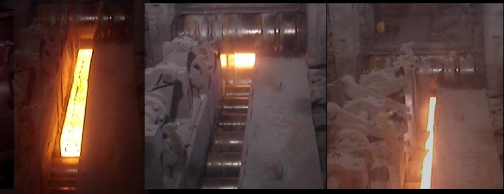
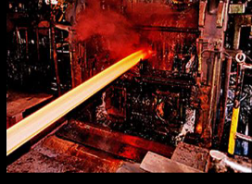
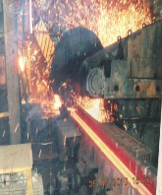
Facilities at Saarloha (Rolling)
Re-heating:
Soaking Pit furnace (for upto 5 MT Ingots) 40 MT / Batch
Walking Beam furnace of 35 MT/ Hr
Blooming Mill
925 mm 2 High Reversible Mill, Morgardshamer (MH, Sweden)
Continuous Oxygen monitoring system in the reheating furnaces
Rolling Mill (22’’)
550 mm DIA 3 High Twin stand Rolling Mill
Continuous Oxygen monitoring system in reheating furnace
Size Range: 80 mm to 200 mm Rounds; 80mm to 340mm RCS

Slide 27
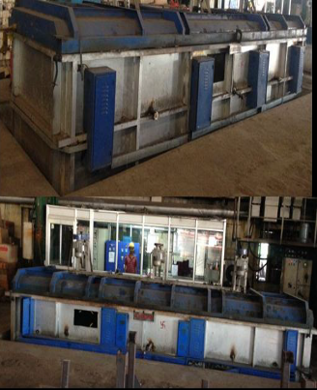
Facilities at Saarloha (Heat Treatment)
Heat Treatment Facilities
Bogie hearth Oil fired annealing Furnaces
1 no - 15 MT batch size
1 no - 30 MT batch size
Bogie hearth Electric Annealing Furnaces
1 no - 15 MT batch size

Slide 28
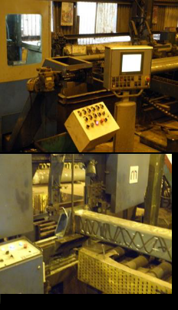
Facilities at Saarloha (Finishing)
Conditioning Facilities
Shot Blasting Machine
Swing Frame Grinders
Band saw – 10 nos (20mm to 400 mm dia)
Roller straightening machine – 2 nos (up to 125 mm dia)
Press straightening machine – 1 no (sizes above 125 dia)
Magnetic Particle Inspection Equipment – 9 no’s

Slide 29
I-ESR & VAR Facilities at Saarloha (Remelting Steel Process)

Slide 30
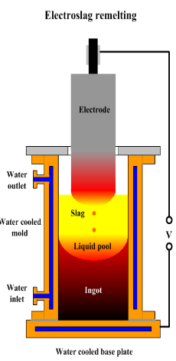
Inert-ESR Features
Make: ALD, Germany
Commissioned: Jan, 2019
One furnace head & two melt stations
Fully computerized auto melt control system
Inert atmosphere: No gas pick up from atmosphere
ESR input and out put gas level is same.
Highly accurate and precise load cells for better melt rate control
Auto slag addition facility
Start up and hot topping fully computer controlled
Provision for Furnace design as per industry 4.0 standard

Slide 31
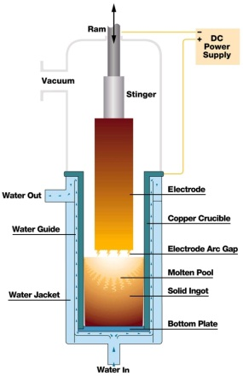
VAR Features
Make: ALD, Germany
Commissioned: Nov, 2018
One furnace head & two melt stations
Fully computerized auto melt control system
Capable of achieving 1 x 10-3 vacuum level
Arc voltage control
Start up and hot topping fully computer controlled
Provision for Furnace design as per industry 4.0 standard

Slide 32
ESR & VAR Capacities
Inert-ESR (~3000 MT per year)
Ingot Size (mm) (Approx.) | Ingot Net Weight (MT) (Approx.)
883 Dia. | 16.6
630 Dia. | 8.4
305 x 360 | 2.7
VAR (~3000 MT per year)
Ingot Size (mm) (Approx.) | Ingot Weight (MT) (Approx.)
897 Dia. | 15.2
670 Dia. | 8.5
Apart from Inert-ESR, we also have an Atmospheric-ESR with sizes 325 mm Sq, 410 mm Dia, 620 mm Dia and 790 mm Dia and ingot weights from 3.5 T to 15.8 T

Slide 33
Production capability (Through re-melting route i.e. ESR / VAR)
Defence
Aerospace
Oil & Gas
Energy
Others
AISI 4130
45XH2MOA-W
18X2H4MA
20XH2MOA-W
30XH2MOA-W
APC-CrNiMo-V
Class F431
AISI 4340
(similar to 300M)
15-5 PH
17-4 PH
15CDV6
SS 304 / 304L
AISI 420
AISI 316
08X14H7M
SS 321
30CD12
35NCD16
08X14H7M
14X18H4
SS0814C
Custom 450
15-5 PH
Custom 450
SS 403Cb
X20Cr13
SA266Gr.3
SA350LF2
EN36C
AISI410
SS321
12Cr
EN24
X10CrNiMoV12-2-2
X22CrMoV12-1
EN24
EN36C
17-4 PH
50CrMo4+Ni+V
SCM420H

Slide 34
New Grades under development
Steel | Chemical Composition (wt %) |  |  |  |  |  |  |  | Size (mm) | Heat Treatment | Mechanical Properties |  |  |  |  |  |  | Applications
Grade | C | Si | Mn | Cr | Ni | Mo | Co | V |  |  | YS | UTS (MPa) | %E | %RA | CVN, J | KIC, MPa√m | YS/ UTS
K190 | 0.36 | 1.93 | 0.75 | 2.5 | 3.06 | 0.49 | - |  | 65 RCS | Hardening -1040°C/2hrs/OQ Tempering - 210°C/4hrs | 1421 | 1882 | 12.96 | 40 | 34 | 87 | 0.82 | Defense & Aerospace
DMR 1700 | 0.35 | 1.92 | 0.55 | 1.15 | 3.05 | 0.51 | 0.3 | - | 60 RCS | Hardening - 940°C/2hrs/OQ Tempering - 280°C/4hrs | 1602 | 1889 | 10.14 | 37.96 | 30 | 77.08 | 0.85 | Missile casing
K150 | 0.26 | 0.28 | 0.42 | 1.63 | 2.54 | 0.51 | - | - | 60 RCS | Normalizing – 925°C/2Hrs Hardening - 885°C/2hrs/WQ Tempering - 220°C/4hrs | 1376 | 1584 | 11.54 | 47.89 | 34 | 78.14 | 0.87 | Armour vehicles
K43 | 0.33 | 0.1 | 0.46 | 2.0 | 3.53 | 0.59 | - | - | 100 RCS | Normalizing – 950°C/2Hrs Hardening - 860°C/2hrs/WQ Tempering - 565°C/4hrs | 964 | 1070 | 14 | 62 | 81@ -20°C | 190 | 0.9 | Oil & Gas and Engineering
300M | 0.4 | 1.5 | 0.7 | 0.8 | 1.8 | 0.4 | - | 0.07 | 75 RCS | Hardeniing - 870°C/2.5Hrs/OQ Double tempering - 300°C/4Hrs | 1718 | 1983 | 8.5 | - | 24 | 59 | 0.87 | Landing Gear

Slide 35
Quality Facilities

Slide 36
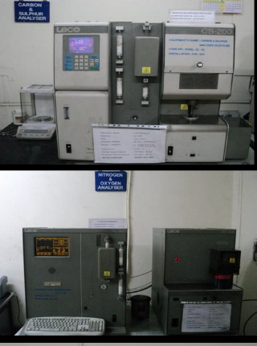
Quality Assurance Facilities at Saarloha (NABL accredited Lab)
02 Direct reading emission spectrometers (48 channels)
03 Mobile Spectrometers
07 MPI machines & Eddy current testing machine
Carbon & Sulphur Determinator (LECO make)
Hydrogen Analyzer & Nitrogen/Oxygen Analyzer (LECO make)
Structures Metallographic Polishing machines
Metallurgical microscopes with photography capabilities
Carl Zeiss microscope (HD-100) with image projection facilities
Ultrasonic portable flaw detectors

Slide 37
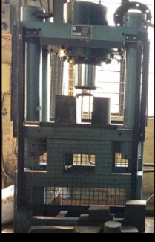
Quality Assurance Facilities at Saarloha
Universal Tensile testing machine (UTM – 40 T)
Impact at subzero temperature
Jominy end quench equipment
Wet analysis lab
Rockwell, Brinell and Vickers hardness testing machines

Slide 38
Baramati Speciality Steels Ltd (Satara, ~120 km from Pune)
BARAMATI SPECIALITY STEELS LTD.
Adding Value To Steel

Slide 39
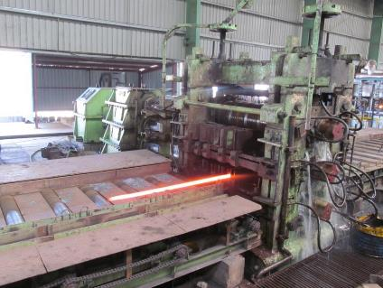
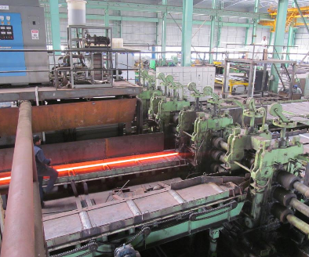
Rolling – Rounds, Squares & Flats
Sizes:
Rounds : 20 mm to 75 mm
Squares : 25 mm to 80 mm
Rolling Capacity:
3000 MT/month
510 mm Roughing Mill : Reversible
380 mm 4 Stand Finishing Mill
310 mm 4 Stand Continuous Mill
10 TPH Fully Automated Reheating Furnace.
BARAMATI SPECIALITY STEELS LTD.
Adding Value To Steel

Slide 40
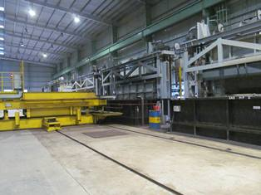
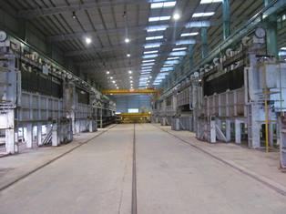
Heat Treatment
Installed Capacity & Capability
2250 MT/ Month
(Size 6m X 750mm – 5T Per Batch) Electrically Operated
SCADA Controlled Real Time TT monitoring With Water/Polymer/Oil Quenching & Auto Load Unload Facility
Heat Treatment Processes
Hardening & Tempering.
Annealing – Iso & Solution
Normalising
Furnaces 5 For Hardening / Normalising & 7 For Tempering / Annealing.
Max Temp 1100ºC
BARAMATI SPECIALITY STEELS LTD.
Adding Value To Steel

Slide 41
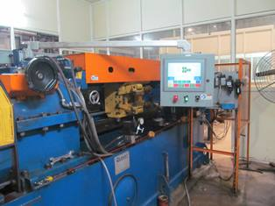
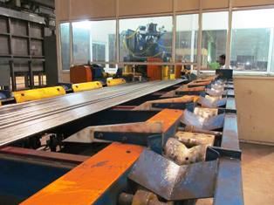
Bright Bar Products
1” Peeling Line
600 MT/ Month
Size Range : 16 mm to 40 mm Dia
Straightener, Burnisher, Centreless Grinder & ECT
Capability: Tolerance -H9/H11, Surface Finish - RA 0.8 μm or better , Straightness 0.75mm/m
8” Peeling Line
1000 MT/ Month
Size Range : 41 mm to 200 mm Dia
Burnisher – 20-160mm Dia.
Centerless Grinding 20-50mm Dia
Belt Polishing upto 90mm Dia.
Capability : Tolerance -H9/H11, Surface Finish - RA 0.8 μm or better ,
Straightness 1.0 mm/m
BARAMATI SPECIALITY STEELS LTD.
Adding Value To Steel

